Slide 1

TEXT MINING PROJECT mental health
ISM 6359 – Datamining
Professor Ryan LaBrie
Ngoc Oanh Nguyen

Slide 2
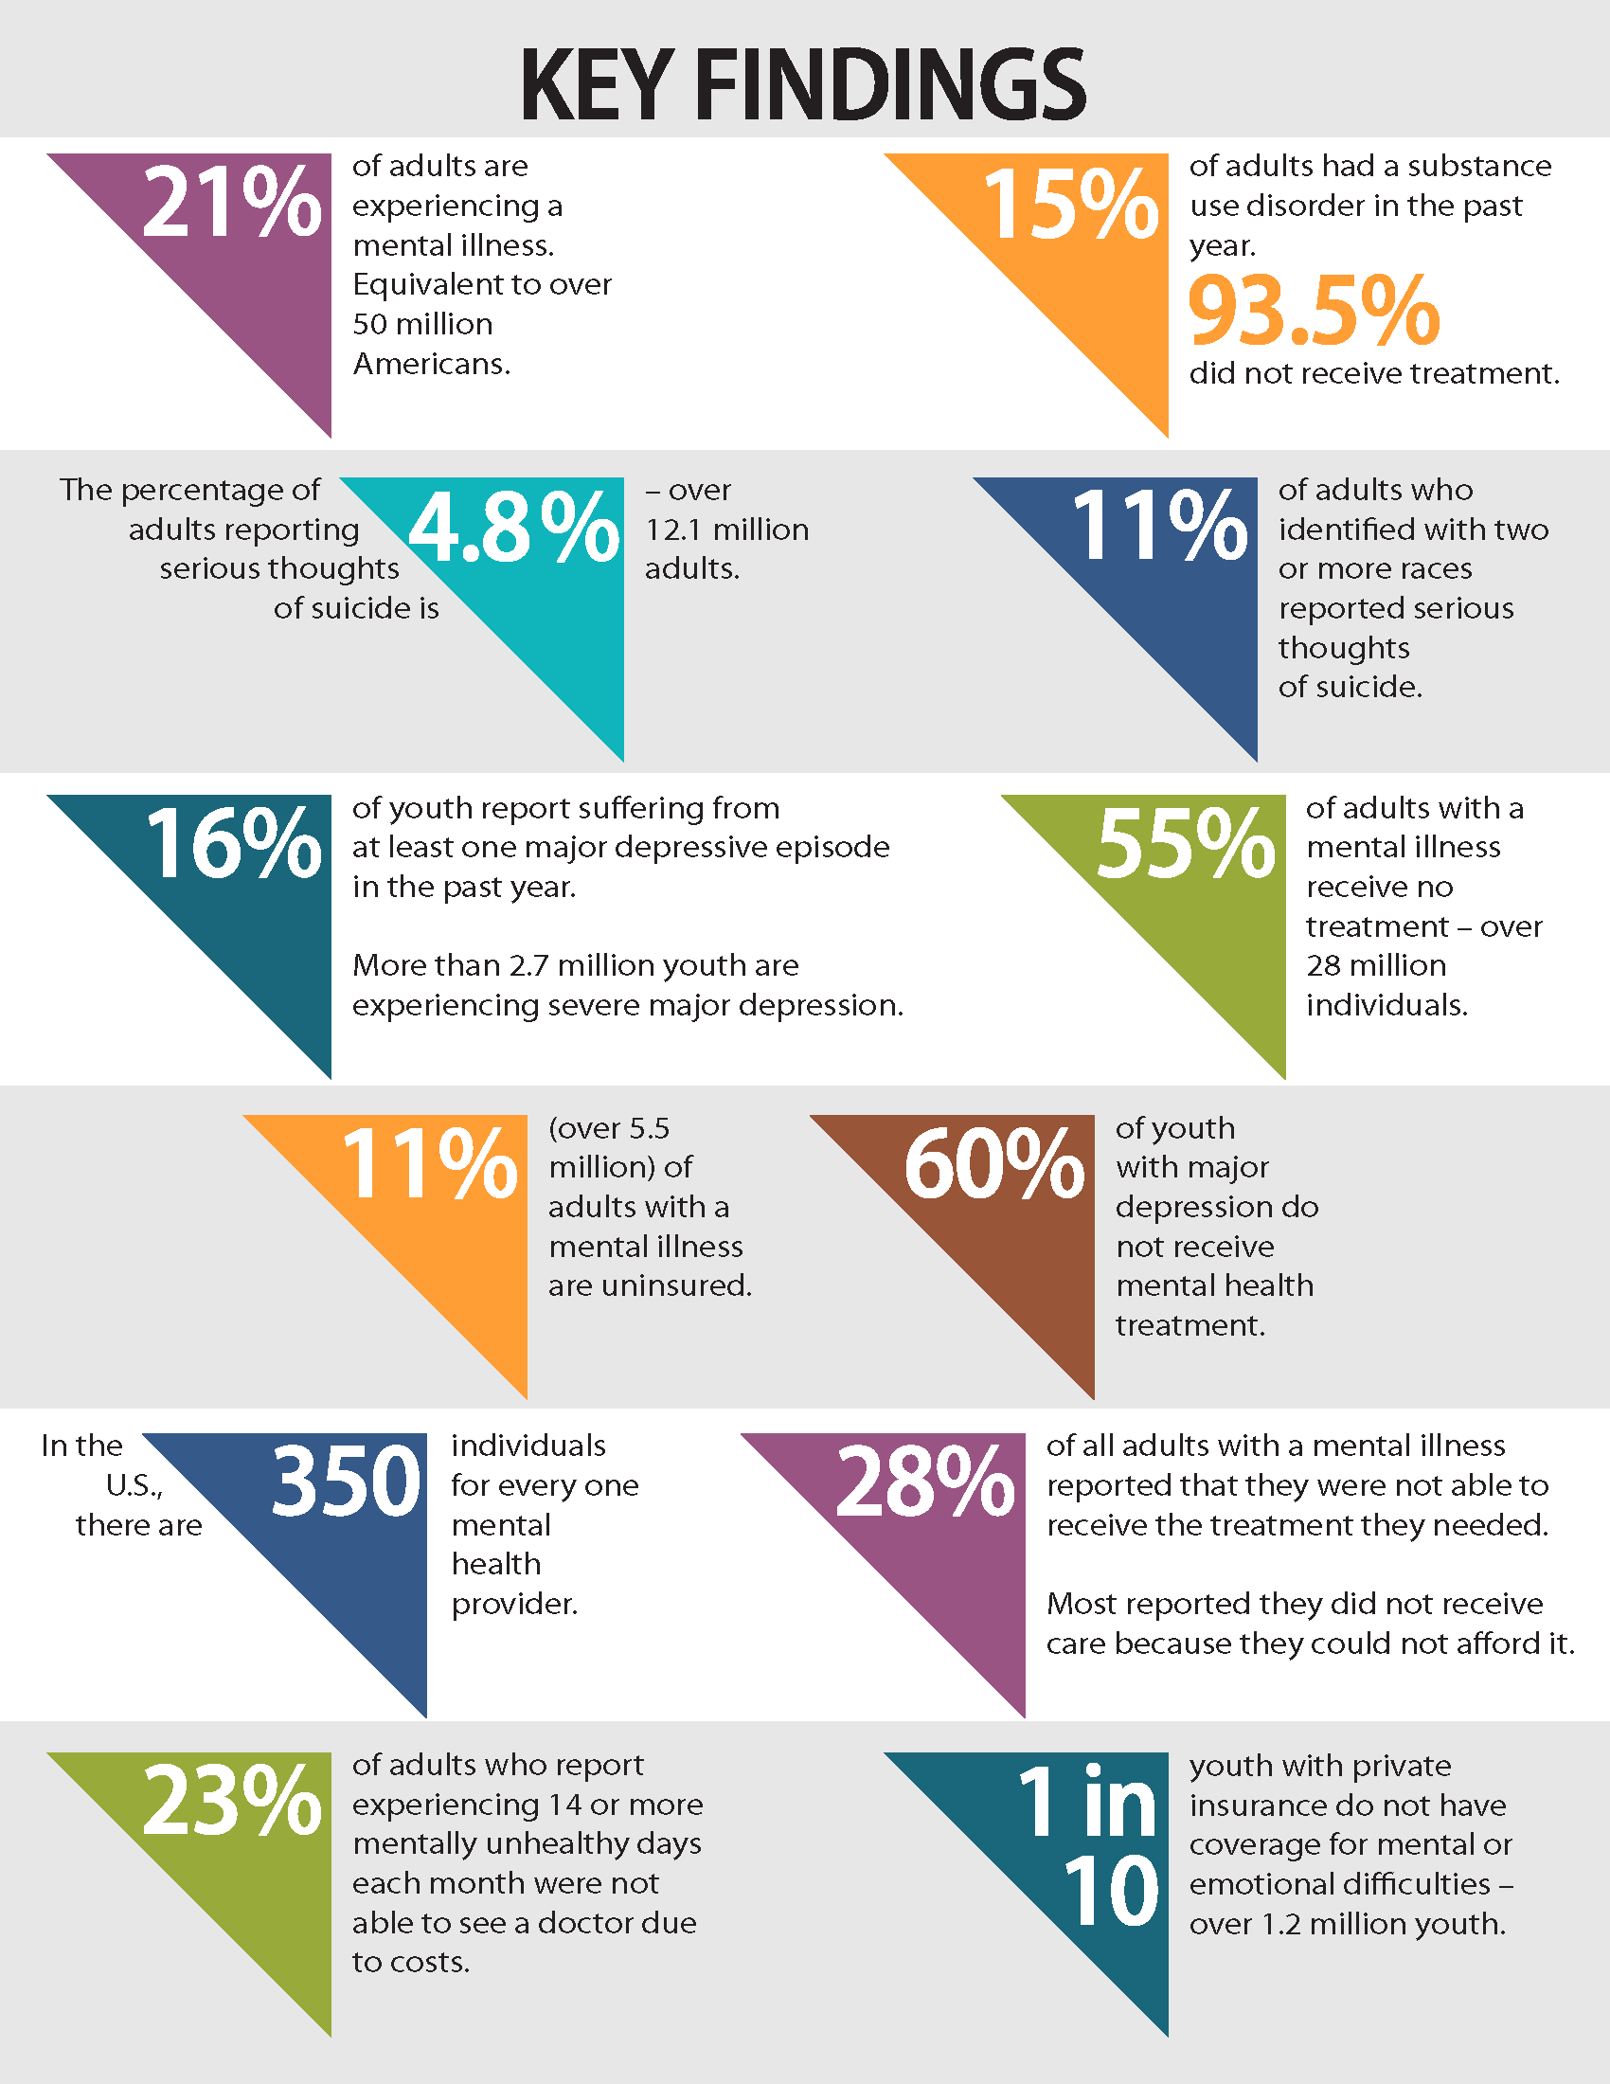

Business problem
$∘$2019-2020 - 20.78% adults - over 50 million
$∘$4.84% thoughts of suicide - over 12.1 million
$∘$28.2% of all adults - have a mental illness

Slide 3
DATA
Mental Health Corpus on Kaggle Dataset Link
Anxiety, depression, and other mental health issues
28,000 documents
2 columns
Comments
Labels - poisonous or not
Toxic language detection

Slide 4

TOOL
Simple UI
Helpful tutorials
Continue exploring Orange
Similar to RapidMiner

Slide 5
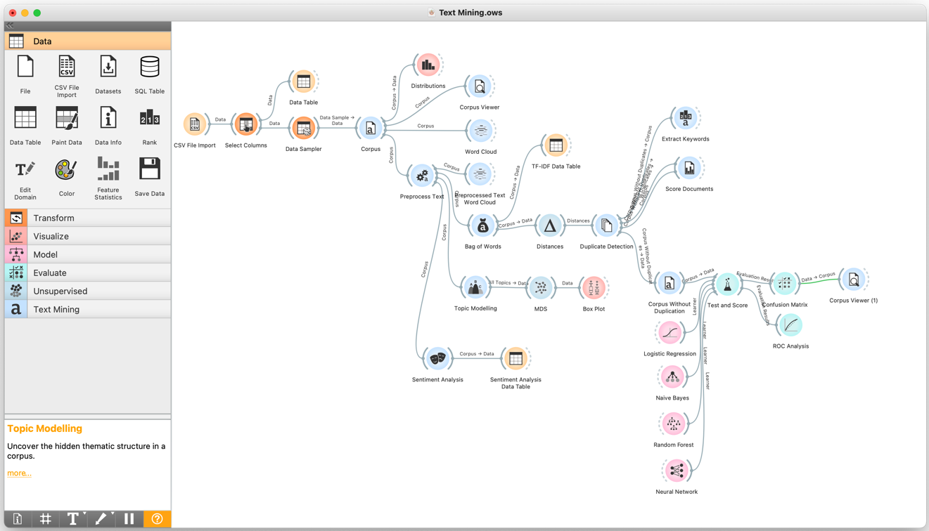
Workflow

Slide 6
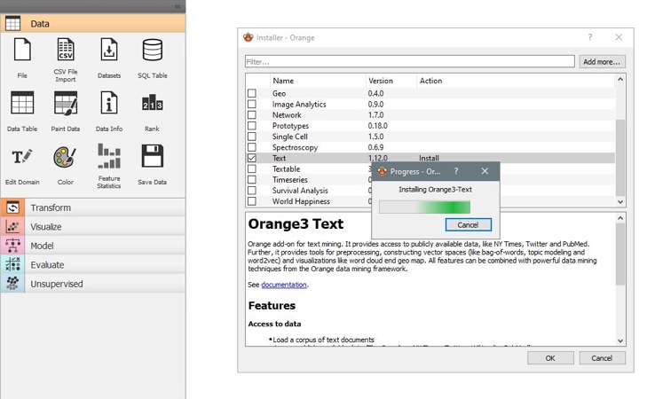
Text mining installation

Slide 7
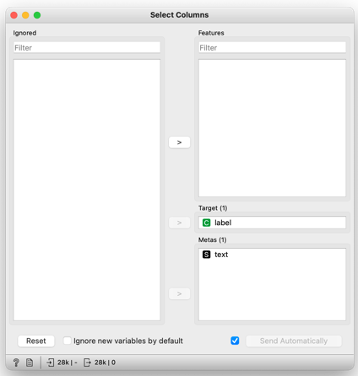
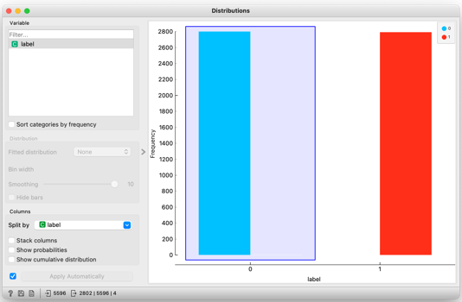
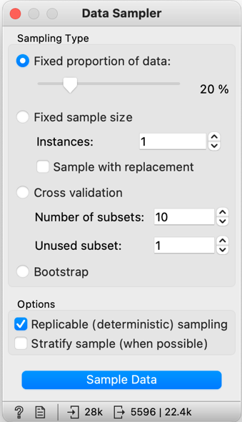
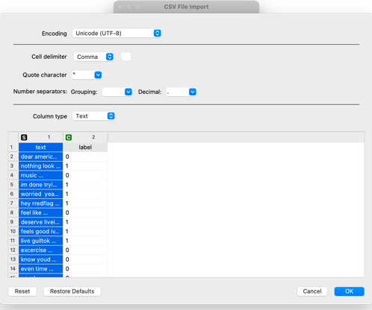
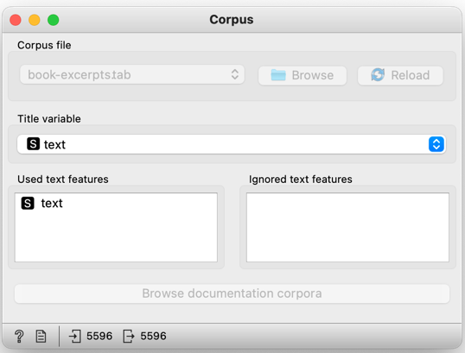

Slide 8
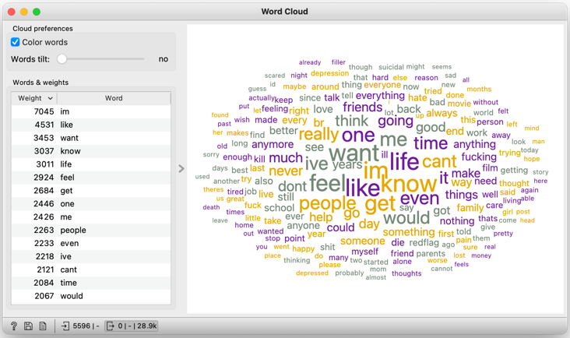
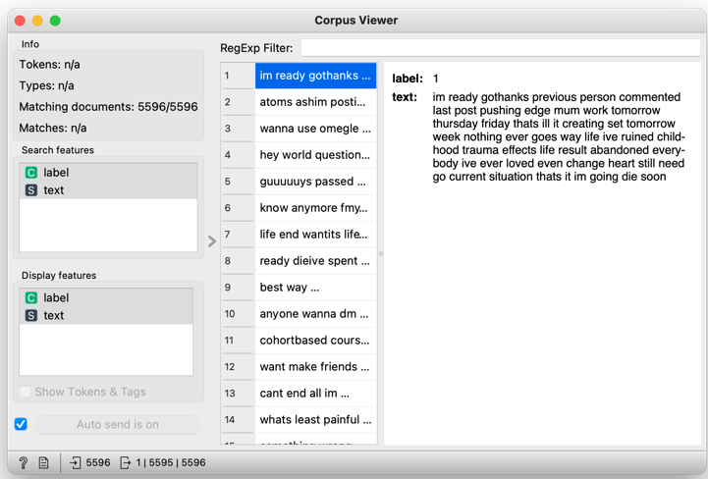
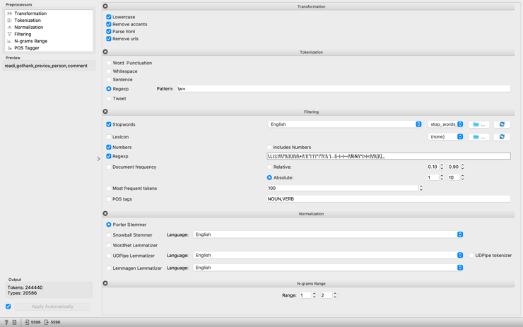
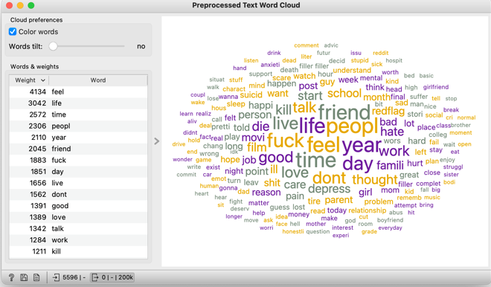
Preprocessing text

Slide 9
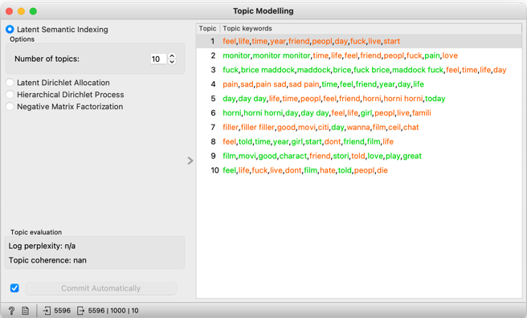
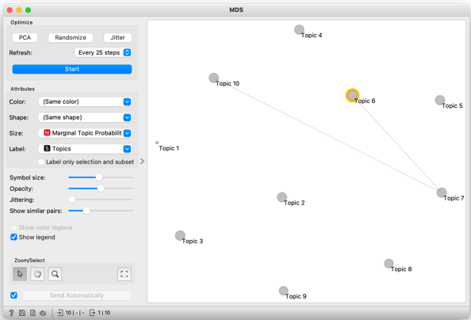
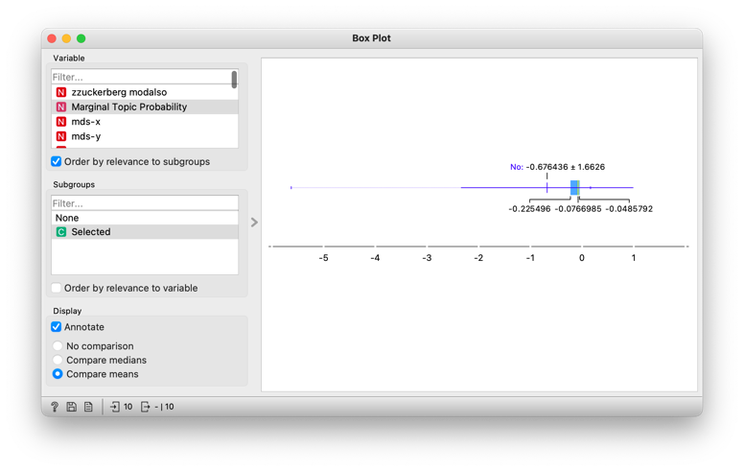
Topic modeling

Slide 10
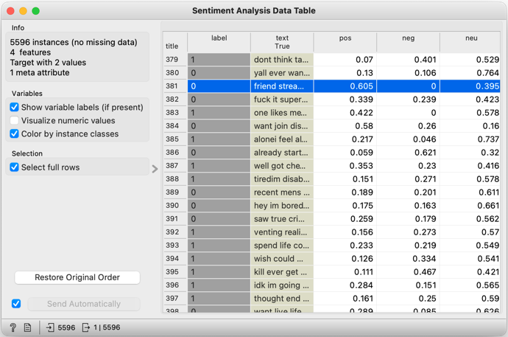
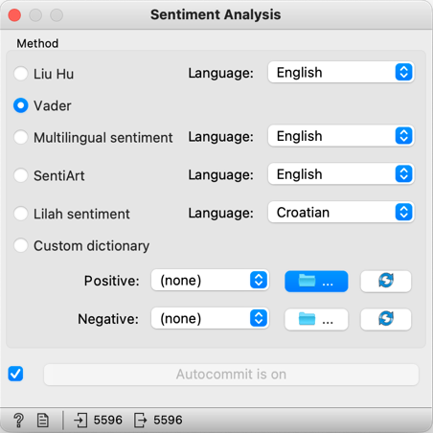
Sentiment analysis

Slide 11
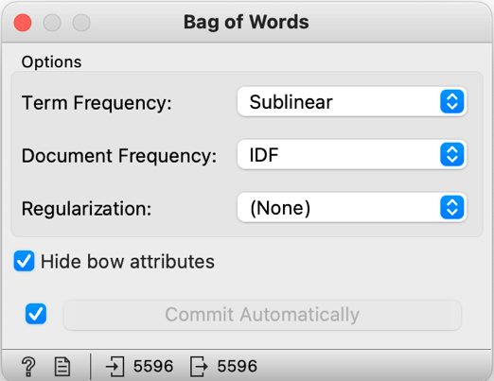
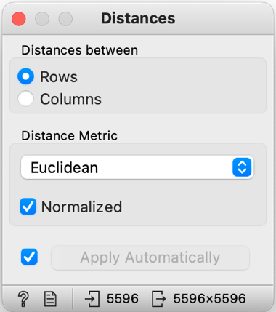
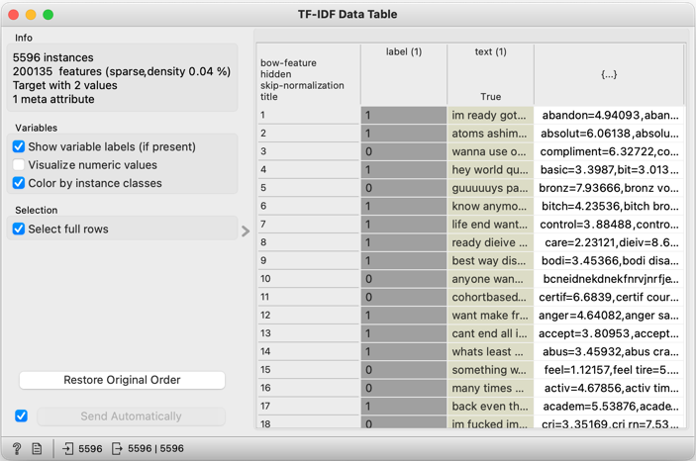
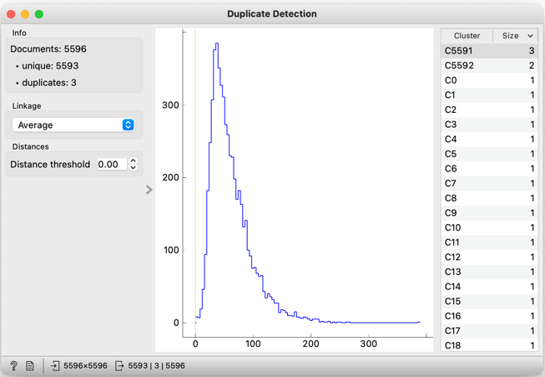

Slide 12
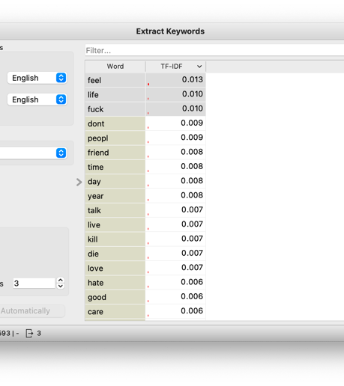
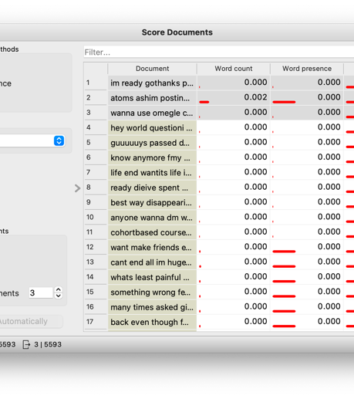

Slide 13
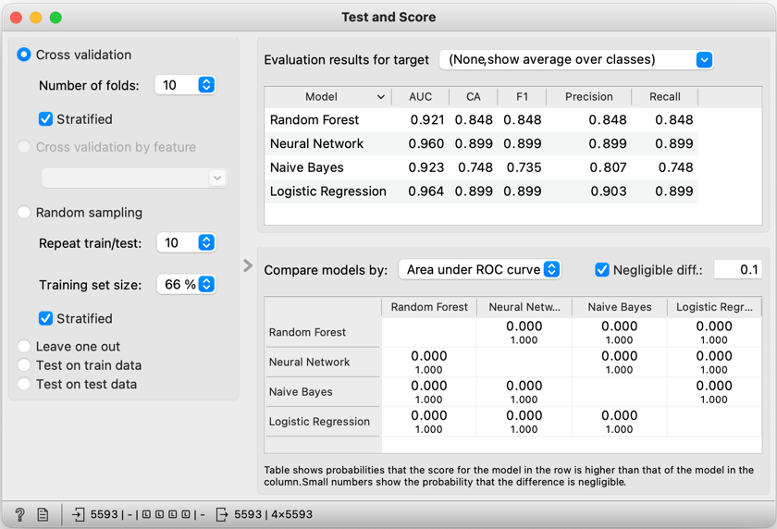
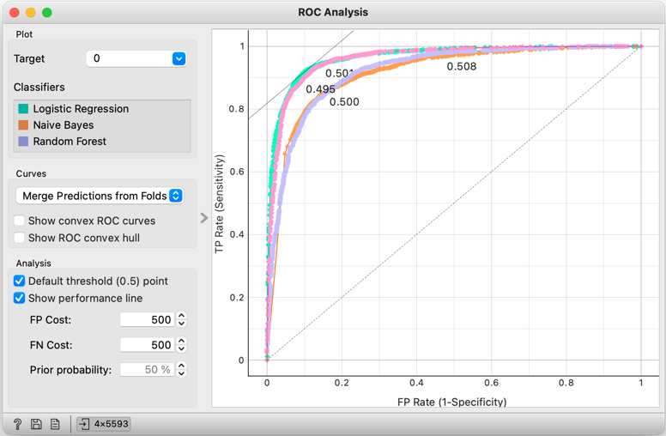
results

Slide 14
The 3w questions
What Went Well
A clean dataset one
Preprocessing phase run smoothly
Similar to RapidMiner
What Did NOT go Well
Find a good dataset is extremely time-consuming
My computer crashed a lot of times - sample the dataset down to 20% - long time to run
What Would I do Differently Next Time
Spend more time exploring the data
Detect the outliers
Try a different dataset & tool

Slide 15
Thank you for listening

